Slide 1






INFOSYS SPRINGBOARD INTERNSHIP PROJECT
SMART ENERGY CONSUMPTION ANALYSIS & PREDICTION
AI-Driven Energy Forecasting & Optimization System
PUNITH V

Slide 2





Technology Stack
Technology Stack Used in the Project
  Python — Data Processing & ML
  Pandas / NumPy — Data Handling
  Scikit-learn — ML Models
  TensorFlow/Keras — LSTM Deep Learning
  Streamlit — Interactive Dashboard
  Matplotlib / Plotly — Visualization

Slide 3





Core Features
Core Features of Smart Energy Predictor
  Predicts future electricity consumption
  Real-time input based forecasting
  Interactive analytics dashboard
  Device-level usage insights
  Intelligent energy-saving suggestions
  Visual trend analysis charts

Slide 4


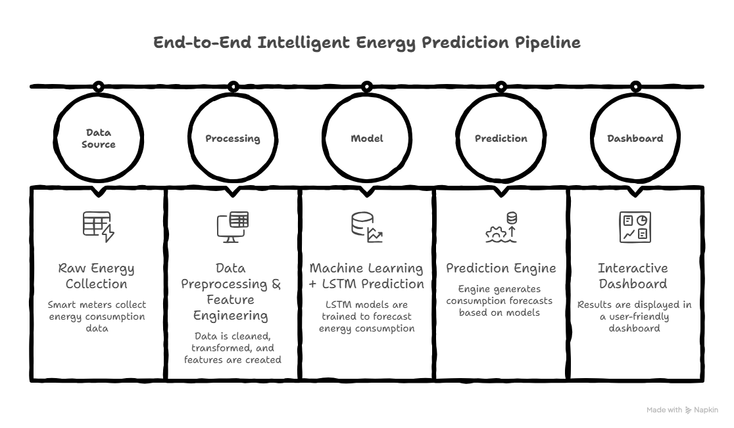


System Architecture

Slide 5


Challenges
Challenges in Energy Consumption Monitoring
  No real-time visibility of electricity usage
  Users cannot predict future consumption trends
  Energy wastage often goes unnoticed
  No automated detection of abnormal usage
  Lack of intelligent recommendations for optimization

Slide 6


Solutions
1
  AI model predicts future energy consumption accurately
  Interactive dashboard for real-time monitoring & visualization
  Cleaned and processed data for reliable analysis
2
  Trend detection using charts and usage patterns
  Alerts for abnormal or high consumption levels
  Smart recommendations for energy optimization

Slide 7
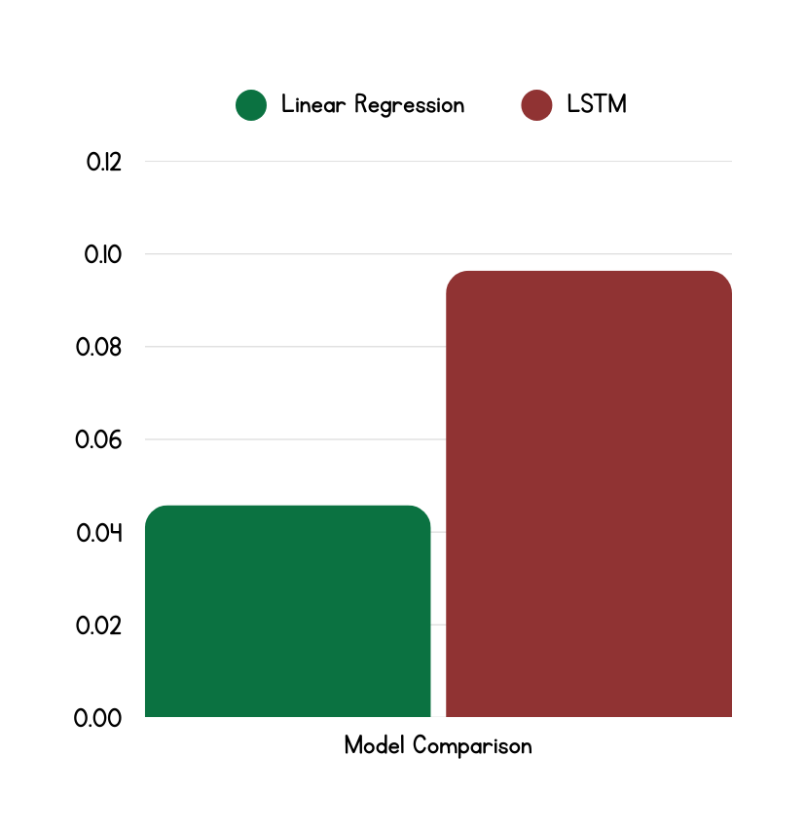
Model Performance & Results
  The system analyzes household energy data and predicts consumption using ML and deep learning models.
  Linear Regression provides a reliable baseline, while LSTM captures time-series patterns.
  The final solution delivers real-time predictions, detects high usage, and suggests optimizations for efficient monitoring.
Lower RMSE = Better Performance

Slide 8
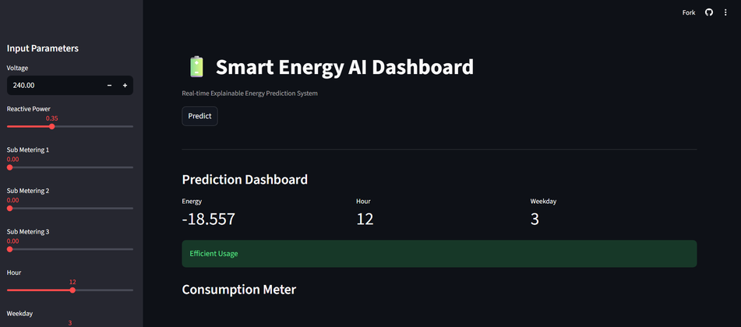
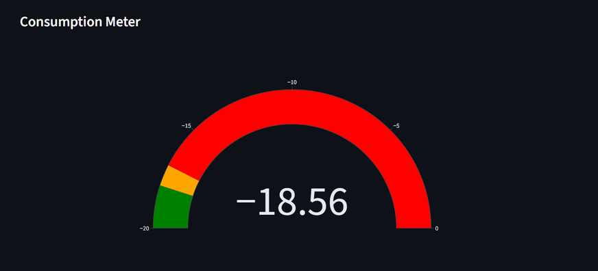
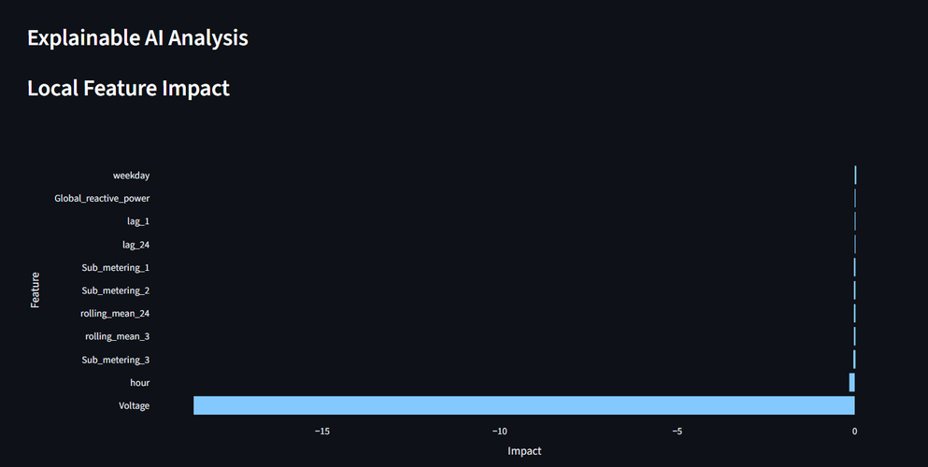
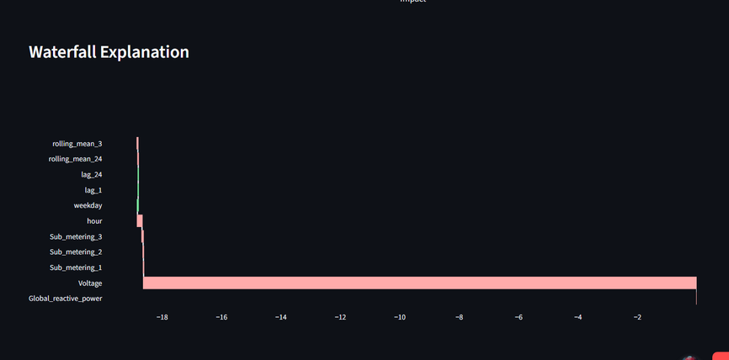
Dashboard Preview

Slide 9

Conclusion
This project successfully developed an end-to-end smart energy prediction system that analyzes real household electricity consumption data using machine learning and deep learning models. By comparing multiple approaches with RMSE evaluation, the most effective model was identified and integrated into an interactive dashboard that provides real-time predictions, visual insights, and intelligent energy-saving recommendations. The system demonstrates how AI can transform raw power usage data into meaningful insights, offering a scalable solution for efficient and intelligent energy monitoring.

Slide 10
THANK
YOU

